Slide 1
Student Management System -2306 Semester Project-
Group 12: Ricardo Reyes, Jarrett Barden, Julian Rodriguez
Instructor: Dr. Avdesh Mishra

Slide 2

Django framework
Originally and mostly used for web development applications
Specifically designed for Python
Ideal for projects that involve managing data and creating web-based interfaces.

Slide 3
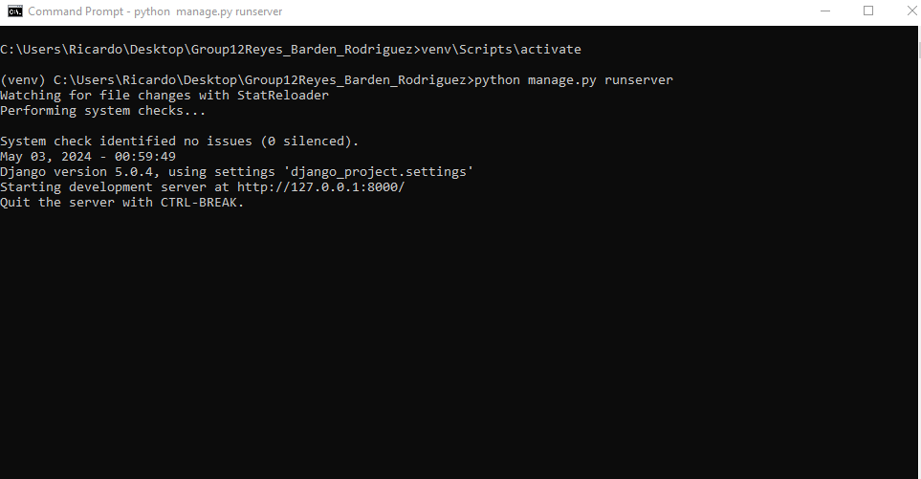
Start up commands
After going through directory, activate the venv using ‘\venv\Scripts\activate’
The command ‘python manage.py runserver’ is what starts the server that then enables us to see the webpage

Slide 4
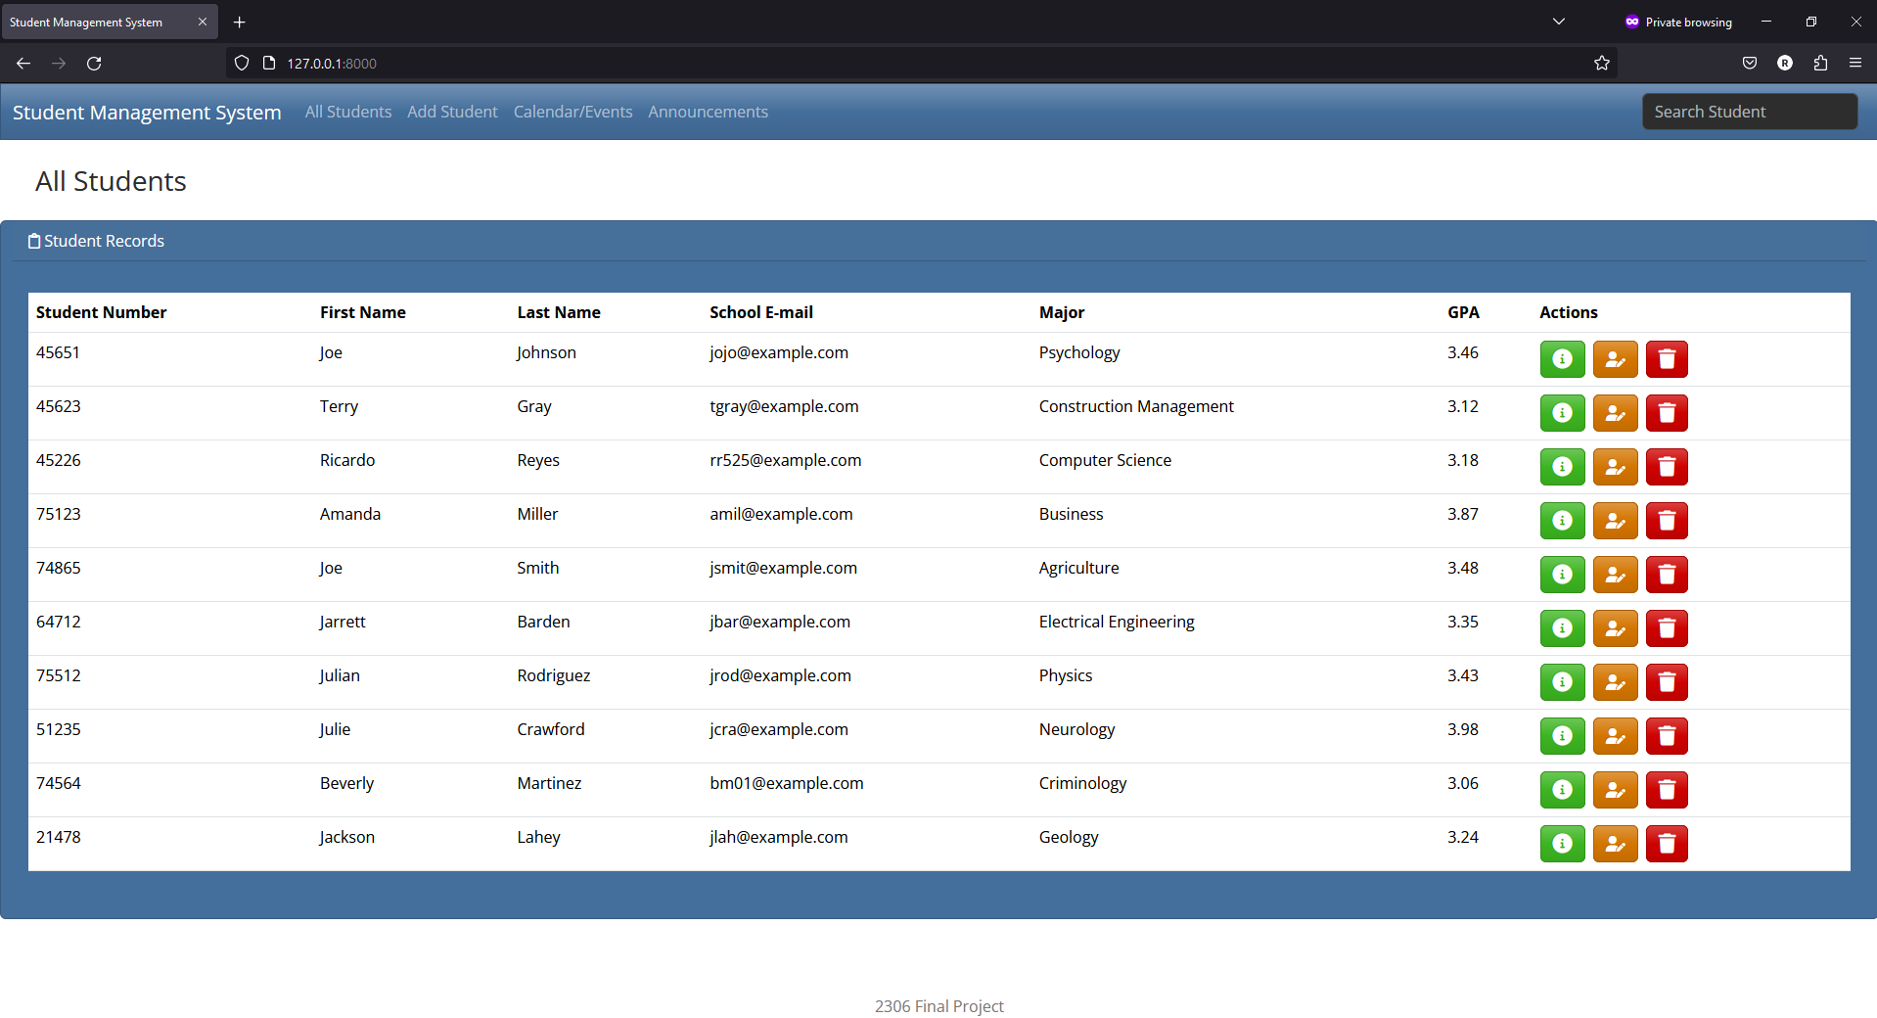
After entering server url

Slide 5

All students page - index
Displays student’s information that is stored within a database
Has three functions:
viewing student info (green),
editing student info (yellow),
deleting a student (red)
Each of the buttons directs the user to desired location

Slide 6
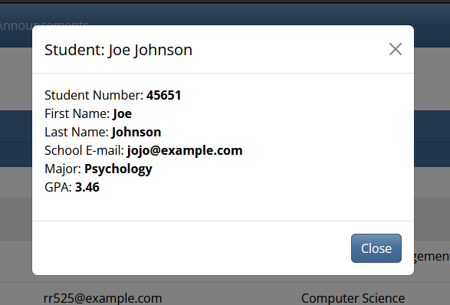
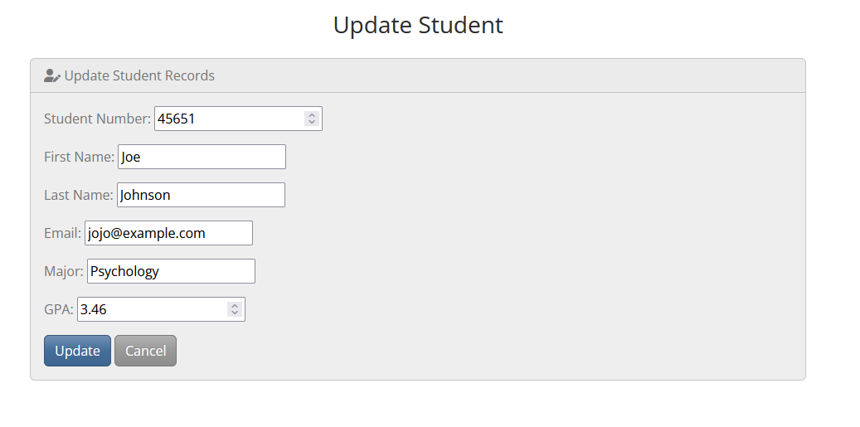
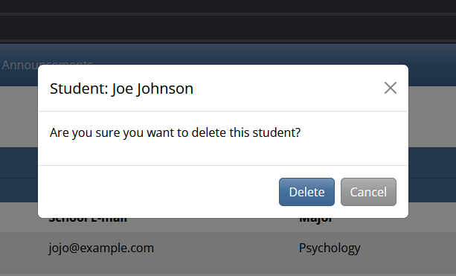

Slide 7
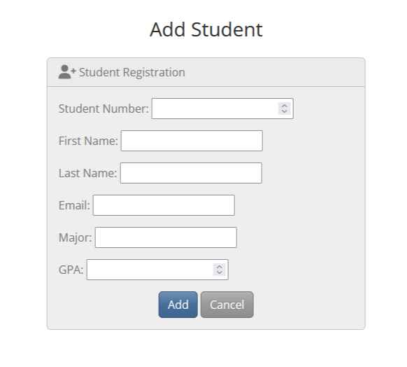
Add student
Adds student to database and displays new student in ‘All Students’ page

Slide 8
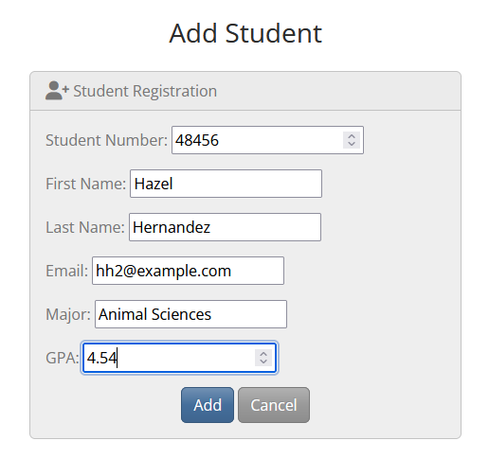
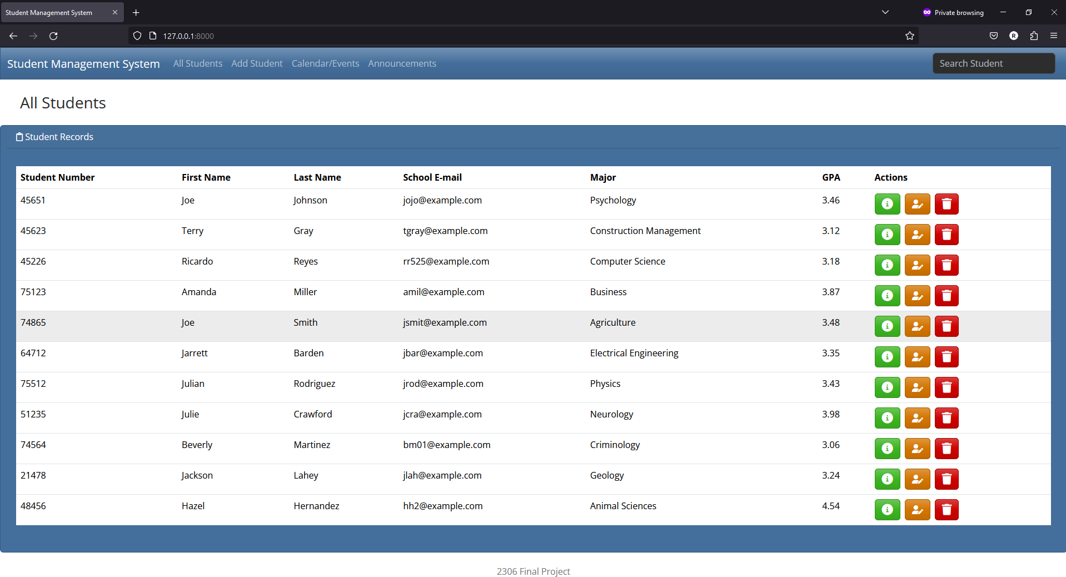

Slide 9
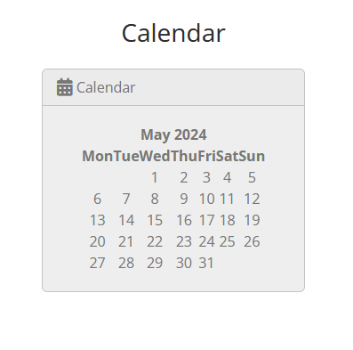
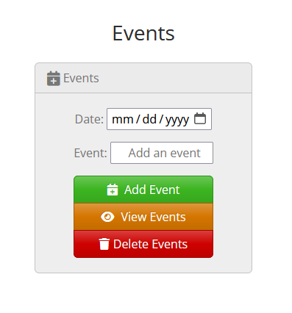
Calendar/Events
Displays a calendar that doesn’t have any functionality. Trouble with formatting issues.
Events section has three functions similar to ‘All Students’ tab:
add event (green)
view event (yellow)
delete event (red)

Slide 10
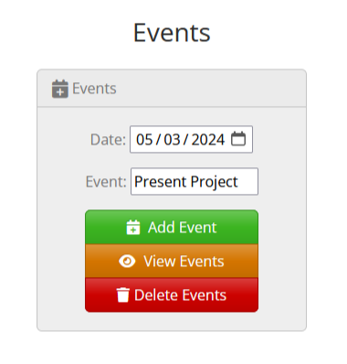
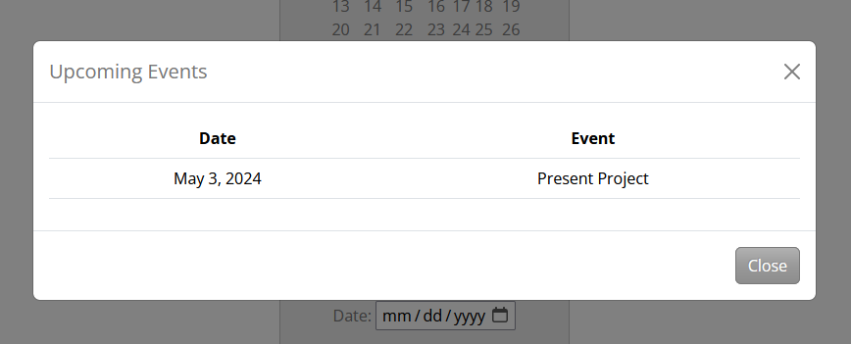
Adding event

Slide 11
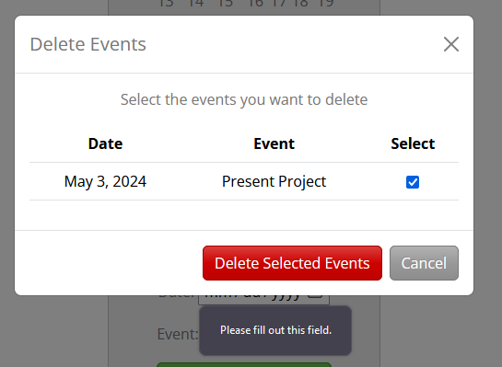
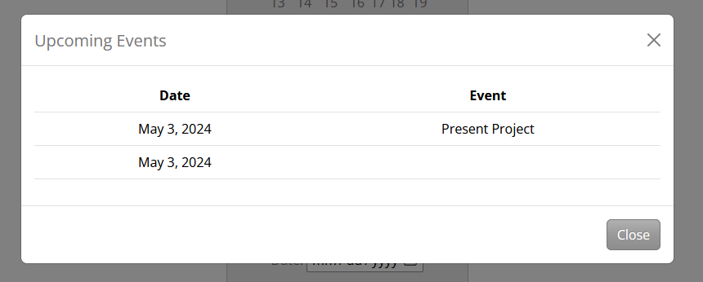
Delete Event
Different errors when using ‘Delete Events’ button:
Selected events that are meant to be deleted can’t be until calendar field is filled out
Once complete, the view button still has the event and an added date

Slide 12
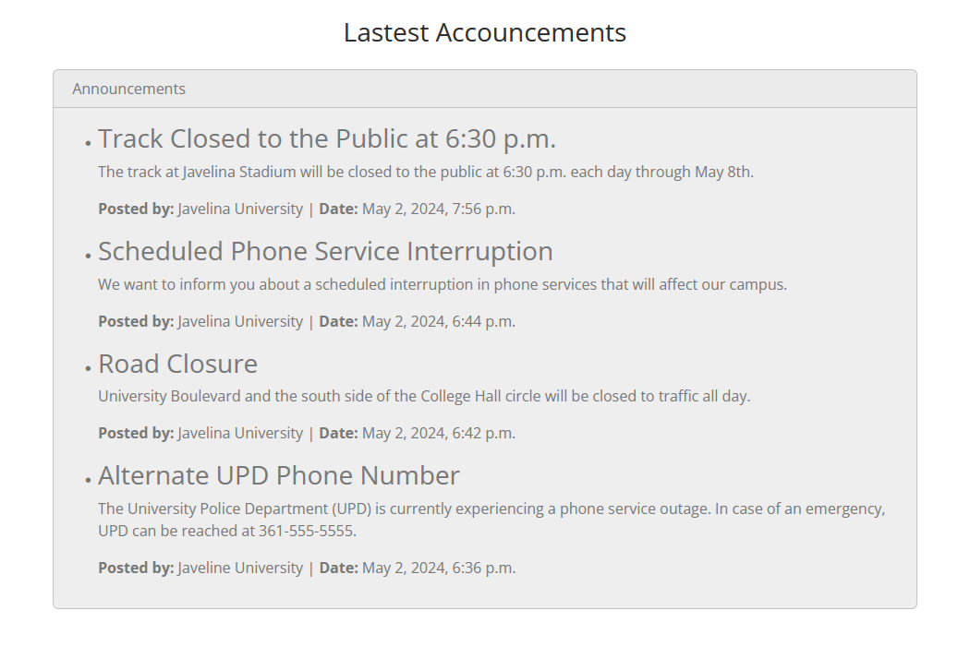
Announcements
Implemented through admin page that can be added or deleted
No functionality rather than receiving different announcements

Slide 13
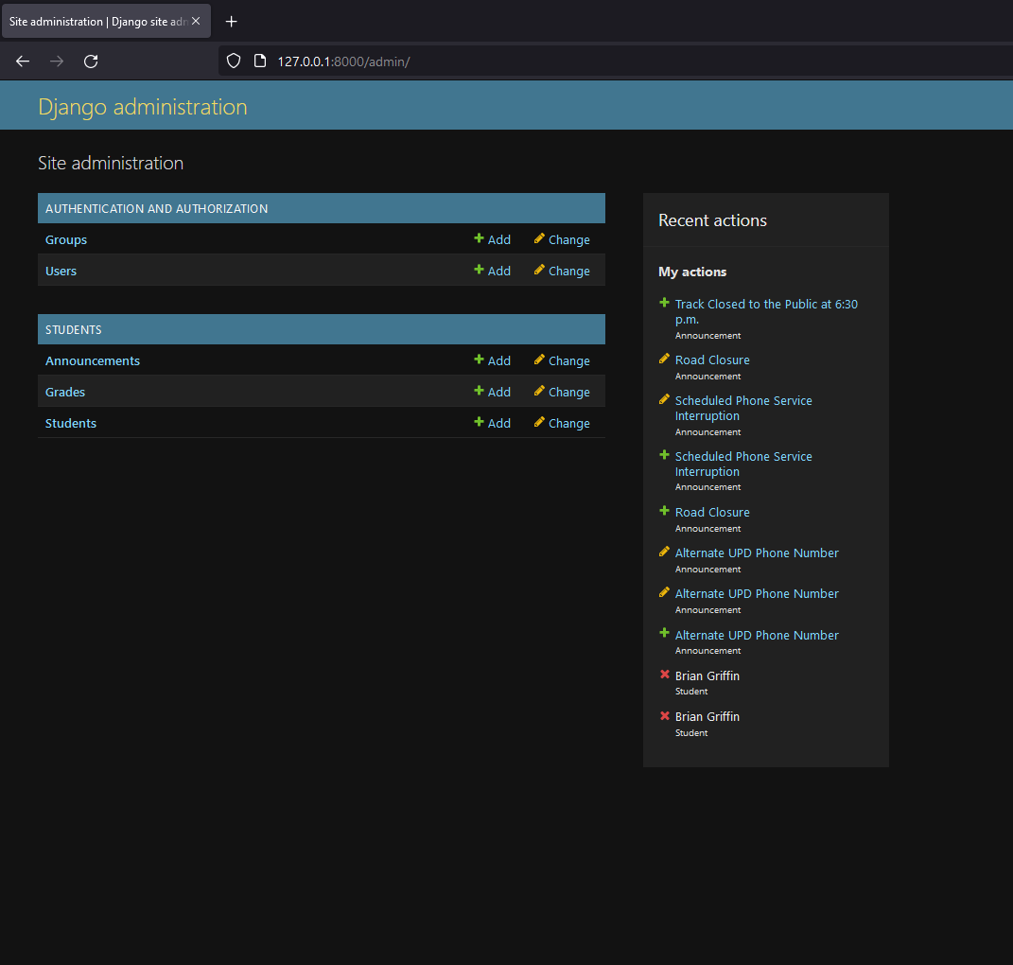
Admin page
Provided by Django, the administration page can add or edit any of the tables associated in the database if they are linked to the admin module.

Slide 14
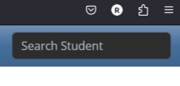
Search student
Added a search bar in the nav bar to search for students and their information
Can find students using first name, last name, or a letter that’s relevant to a student’s name
Problems searching by full name

Slide 15
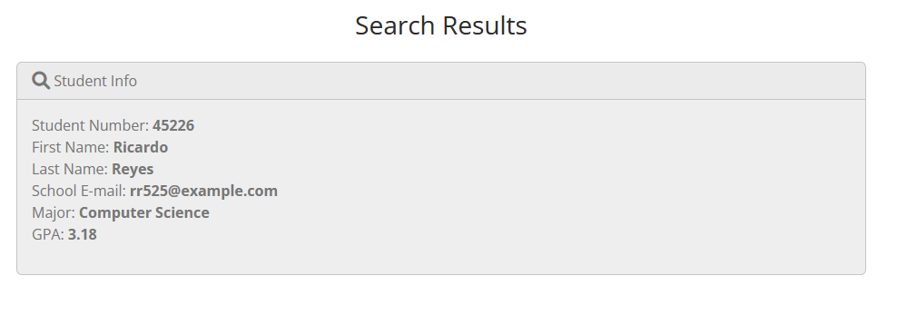

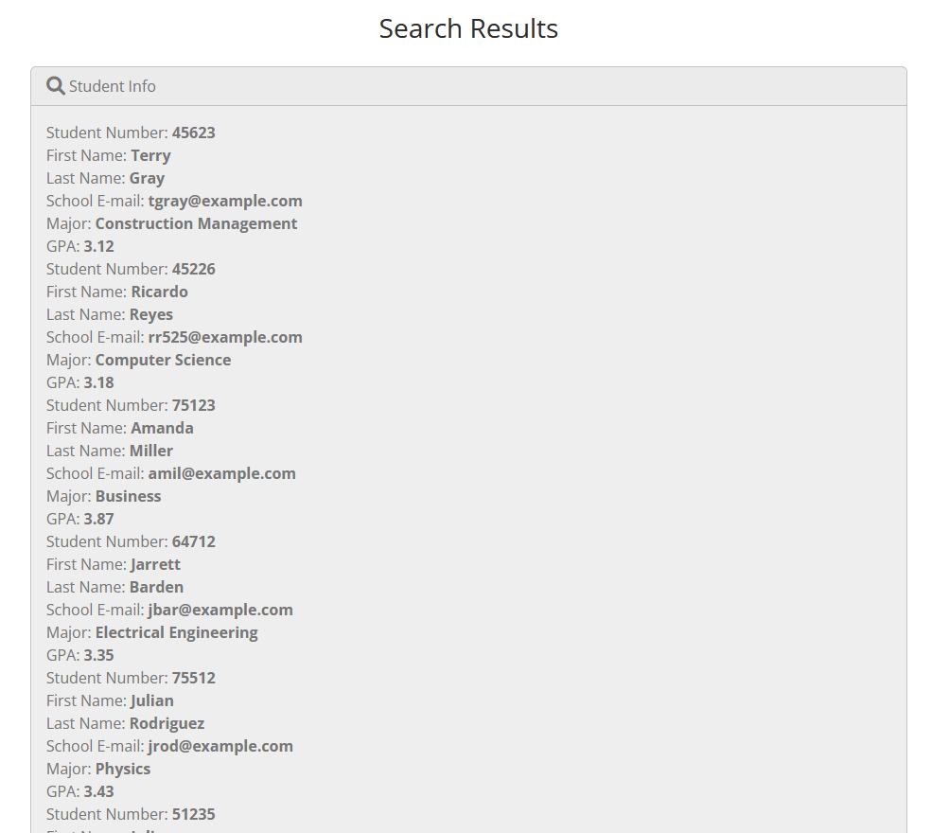


Slide 16
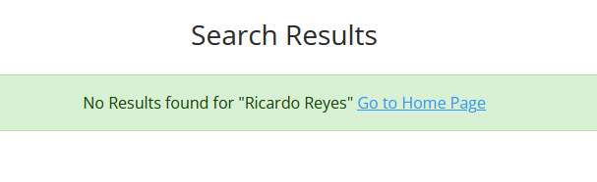


Slide 17
Summary of Applications
All Students
Has three functions that views, edits, and deletes student information
Add Students
Function that adds new student and info into database
Calendar/Events
Has three functions as well that views, edits, and deletes events
Search Bar
Search students by name and displays their information

Slide 18
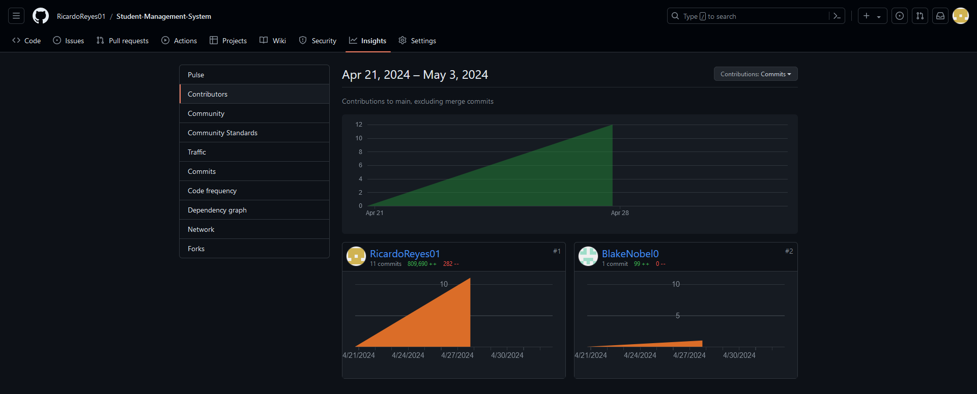
Contributions
GitHub link was sent to all members and were contacted by phone and/or email
Ricardo Reyes: Almost if not all contributions
Jarrett Barden: Passed a commit to GitHub
Julian Rodriguez: No contributions

